Slide 1

SCC.361: Artificial Intelligence
2024-2025
Week 09 – Lecture 1
Neural Networks Cont.
Hossein Rahmani
Prof. in Computer Vision and Machine Learning
Email: h.rahmani@lancaster.ac.uk

Slide 2
Outline
Decision Surface
Perceptron
Binary classification
Discrete vs Continuous Perceptron
Multi-class classification
Softmax function
Error/Loss functions
Mean Square Error (MSE)
Maximum Likelihood (ML)
Cross-Entropy (CE)
Multi Layer Perceptron (MLP)

Slide 3
Review: Maximum Likelihood
Step 1: Both probabilities have been shown for each sample for each model
Step 2: Calculate the probability of all 6 samples are of the classes that they actually are
Model 1
$$x_{1}$$
0.70 likely
$$0.85×0.70×0.40×0.70×0.40×0.80=0.053312$$
0.30 likely
0.85 likely
0.15 likely
Probability for
Model 1
0.40 likely
0.60 likely
0.60 likely
0.40 likely
0.20 likely
0.80 likely
0.30 likely
$$x_{2}$$
3
0.70 likely

Slide 4
Review: Maximum Likelihood
Step 1: Both probabilities have been shown for each sample for each model
Step 2: Calculate the probability of all 6 samples are of the classes that they actually are
Model 2
$$x_{1}$$
0.75 likely
$$0.60×0.75×0.65×0.60×0.75×0.70=0.0921375$$
0.25 likely
0.60 likely
0.40 likely
Probability for
Model 2
0.65 likely
0.35 likely
0.40 likely
0.60 likely
0.30 likely
0.70 likely
0.25 likely
$$x_{2}$$
4
0.75 likely

Slide 5
Issues with Maximum Likelihood
So, the aim of learning (for classification) is to maximize this probability of the model
How to maximize this probability?
Product of probabilities (one probability for each sample)
It is hard to maximize products
Moreover, if there are hundreds/thousands of samples, the product of them is very tiny (e.g. 0.000000000003)
Solution: We need to resolve these issues by turning the products to sums!!!
$\log\left(A×B\right)=log\left(A\right)+log(B)$
$\ln\left(A×B\right)=ln\left(A\right)+ln(B)$
5

Slide 6
Maximum Likelihood => Cross-Entropy
$\ln\left(A×B\right)=ln\left(A\right)+ln(B)$
Likelihood of
Model 1
$$0.85×0.70×0.40×0.70×0.40×0.80=0.053312$$
aim is maximize
$$\ln\left(0.85×0.70×0.40×0.70×0.40×0.80\right)=…$$
$$…=ln\left(0.85\right)+\ln\left(0.70\right)+\ln\left(0.40\right)+\ln\left(0.70\right)+\ln\left(0.40\right)+ln⁡(0.80)=$$
$$…=\left(−0.16\right)+\left(−\text{0.3}6\right)+\text{(}−\text{0.9}2)+(−0.36)+(−0.92)+(−0.22)=−2.94$$
Result is always a negative number
aim is minimize
$$−\ln\left(0.85×0.70×0.40×0.70×0.40×0.80\right)=…$$
$$…=−ln\left(0.85\right)−\ln\left(0.70\right)−\ln\left(0.40\right)−\ln\left(0.70\right)−\ln\left(0.40\right)−ln⁡(0.80)=2.94$$
Result is always a positive number
This negative sum of the log probabilities is called
Cross-Entropy
6

Slide 7
Maximum Likelihood => Cross-Entropy
$\ln\left(A×B\right)=ln\left(A\right)+ln(B)$
Likelihood of
Model 2
$$0.60×0.75×0.65×0.60×0.75×0.70=0.0921375$$
$$−ln\left(0.60×0.75×0.65×0.60×0.75×0.70\right)=…$$
$$…=−ln\left(0.60\right)−\ln\left(0.75\right)−\ln\left(0.65\right)−\ln\left(0.60\right)−\ln\left(0.75\right)−ln⁡(0.70)=$$
$$…=−\left(−0.51\right)−\left(−\text{0.}29\right)−\text{(}−\text{0.}43)−(−0.51)−(−0.29)−(−0.36)=2.39$$
This negative sum of the log probabilities is called
Cross-Entropy
7

Slide 8
Cross-Entropy
The aim of learning (for classification) is to maximize the Maximum Likelihood of the model
Now, our aim is to minimize the Cross-Entropy of the model
Likelihood of
Model 1
$$0.85×0.70×0.40×0.70×0.40×0.80=0.053312$$
$$−ln\left(0.85\right)−\ln\left(0.70\right)−\ln\left(0.40\right)−\ln\left(0.70\right)−\ln\left(0.40\right)−ln⁡(0.80)=2.94$$
Cross-Entropy
of Model 1
Likelihood of
Model 2
$$0.60×0.75×0.65×0.60×0.75×0.70=0.0921375$$
$$−ln\left(0.60\right)−\ln\left(0.75\right)−\ln\left(0.65\right)−\ln\left(0.60\right)−\ln\left(0.75\right)−ln⁡(0.70)=2.39$$
Cross-Entropy
of Model 2
8

Slide 9
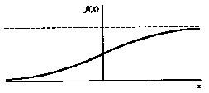
Cross-Entropy Equation
Model 1
$$x_{1}$$
0.70 likely
Synaptic
weights
1
Input
signal
0.85 likely
Bias
b
x₁
w₁
0.40 likely
Σ
v
0.60 likely
ϕ(.)
$$P(BLUE)$$
0.20 likely
0.30 likely
$$x_{2}$$
x₂
w₂
Summing
junction
$$−ln\left(0.85\right)−\ln\left(0.70\right)−\ln\left(0.40\right)−\ln\left(0.70\right)−\ln\left(0.40\right)−ln⁡(0.80)=2.94$$
Cross-Entropy
of Model 1
$$−\sum_{i=1}^{N}{y_{i}\ln\left(P_{i}\right)+{(1−y}_{i}) ln⁡(1−P_{i})}$$
$$y_{i}=\left\{\begin{aligned} \\ \end{aligned}\right.$$
1
Number of
Samples (e.g. 6)
0
9

Slide 10
Multi-Class Cross-Entropy
1
Bias
$$b_{1}$$
$$v_{1}$$
Synaptic
weights
Σ
$$P(C_{1})$$
Number of
Samples
Number of
Classes
Input
signal
1
Bias
$$b_{2}$$
w₁₁
$$−\sum_{i=1}^{N}{\sum_{j=1}^{C}{y_{i,j}\ln\left(P_{i,j}\right)}}$$
x₁
w₁₂
$$v_{2}$$
w₁₃
Softmax Layer
Σ
$$P(C_{2})$$
w₂₁
w₂₂
1
If $i^{th}$ sample belongs to
class $C_{j}$, then: $y_{i,j}=1$
x₂
Bias
$$b_{3}$$
w₂₃
$$v_{3}$$
Σ
$$P(C_{3})$$
10

Slide 11
Non-linear
Decision Boundary
$$x_{1}$$
Non-linear
Decision
Boundary
B
A
B
A
Non-Linearly separable
One perceptron is not enough
A
A
B
A
A
A
B
B
B
B
B
$$x_{2}$$
11

Slide 12
Simple Network
(XOR)
XOR
$$x_{1}$$ | $$x_{2}$$ | out
0 | 0 | 0
0 | 1 | 1
1 | 0 | 1
1 | 1 | 0
$$x_{1}$$
1
0
Non-Linearly separable
One perceptron is not enough
$${w_{1}x}_{1}+{w_{2}x}_{2}+b_{1}=0$$
0
1
$$x_{2}$$
$${w_{3}x}_{1}+{w_{4}x}_{2}+b_{2}=0$$
12

Slide 13
Simple Network
(XOR)
1
XOR
$$x_{1}$$ | $$x_{2}$$ | out
0 | 0 | 0
0 | 1 | 1
1 | 0 | 1
1 | 1 | 0
Bias
$$b_{1}$$
Σ
$$v_{1}$$
W₁
ϕ(.)
x₁
W₂
1
Bias
$$b_{2}$$
W₃
x₂
Σ
$$v_{2}$$
ϕ(.)
W₄
Input Layer
Hidden Layers
13

Slide 14
Simple Network
(XOR) – First Neuron
$$x_{1}$$
$${w_{1}x}_{1}+{w_{2}x}_{2}+b_{1}=0$$
1
0
0
1
$$x_{2}$$
14

Slide 15
Simple Network
(XOR)
1
XOR
$$x_{1}$$ | $$x_{2}$$ | out
0 | 0 | 0
0 | 1 | 1
1 | 0 | 1
1 | 1 | 0
Bias
$$b_{1}$$
Σ
$$v_{1}$$
W₁
ϕ(.)
x₁
W₂
1
Bias
$$b_{2}$$
W₃
x₂
Σ
$$v_{2}$$
ϕ(.)
W₄
Input Layer
Hidden Layers
15

Slide 16
Simple Network
(XOR) – Second Neuron
$$x_{1}$$
$${w_{3}x}_{1}+{w_{4}x}_{2}+b_{2}=0$$
1
0
0
1
$$x_{2}$$
16

Slide 17
Simple Network
(XOR)
1
XOR
$$x_{1}$$ | $$x_{2}$$ | out
0 | 0 | 0
0 | 1 | 1
1 | 0 | 1
1 | 1 | 0
Bias
$b_{1}$=-1.5
Σ
$$v_{1}$$
W₁=1
ϕ(.)
x₁
W₅=-2
Bias
$b_{3}$=-0.5
W₂=1
1
Σ
v
$$y$$
W₃=1
Bias
$b_{2}$=-0.5
ϕ(.)
x₂
Σ
W₆=1
$$v_{2}$$
ϕ(.)
W₄=1
17

Slide 18
Simple Network
(XOR) – Both Neurons
$$x_{1}$$
$${w_{3}x}_{1}+{w_{4}x}_{2}+b_{2}=0$$
1
0
0
1
$$x_{2}$$
18

Slide 19
Simple Network
(XOR)
$$x_{1}$$
1
0
$${w_{1}x}_{1}+{w_{2}x}_{2}+b_{1}=0$$
0
1
$$x_{2}$$
$${w_{3}x}_{1}+{w_{4}x}_{2}+b_{2}=0$$
19

Slide 20
Simple Network
(Example 2)
$$x_{1}$$
1
1
0
0
0
1
1
0
0
1
0
1
0
0
1
1
0
1
1
0
0
0
0
0
1
1
1
1
1
1
1
1
1
1
1
$$x_{2}$$
20

Slide 21
Simple Network
(Example 2 – First Neuron)
$$x_{1}$$
1
1
0
0
0
1
1
0
0
1
0
1
0
0
1
1
0
$${w_{1}x}_{1}+{w_{2}x}_{2}+b_{1}=0$$
1
1
0
0
0
0
0
1
1
1
1
1
1
1
1
1
1
1
$$x_{2}$$
21

Slide 22
Simple Network
(Example 2 - – Second Neuron)
$$x_{1}$$
$${w_{3}x}_{1}+{w_{4}x}_{2}+b_{2}=0$$
1
1
0
0
0
1
1
0
0
1
0
1
0
0
1
1
0
1
1
0
0
0
0
0
1
1
1
1
1
1
1
1
1
1
1
$$x_{2}$$
22

Slide 23
Simple Network
(Example 2 – Combine)
$$x_{1}$$
$${w_{3}x}_{1}+{w_{4}x}_{2}+b_{2}=0$$
1
1
0
0
0
1
1
0
0
1
0
1
0
0
1
1
0
$${w_{1}x}_{1}+{w_{2}x}_{2}+b_{1}=0$$
1
1
0
0
0
0
0
1
1
1
1
1
1
1
1
1
1
1
$$x_{2}$$

Slide 24
Simple Network
(Example 2 – Combine)
$$x_{1}$$
1
1
0
0
0
1
1
0
0
1
0
1
0
0
1
1
0
1
1
0
0
0
0
0
1
1
1
1
1
1
1
1
1
1
1
$$x_{2}$$
24

Slide 25
Simple Network
(Example 2 – Model )
1
Bias
$$b_{1}$$
1
Σ
$$v_{1}$$
W₁
ϕ(.)
x₁
w₅
Bias
$$b_{3}$$
W₂
1
Σ
v
$$y$$
Bias
$$b_{2}$$
ϕ(.)
W₃
x₂
Σ
w₆
Output
Layer
$$v_{2}$$
ϕ(.)
W₄
Input Layer
Hidden Layers
25

Slide 26
Multi-Layer Perceptron
(One hidden layer)
Input Layer
Hidden Layers
Output
Layer
x₁
x₂
x₃
x₄
x₅
x₆
x₇
=
Σ
ϕ(.)
26

Slide 27
Question: (Example 3)
$$x_{1}$$
1
1
1
1
1
1
0
0
1
1
0
1
0
0
1
0
1
1
0
0
1
0
0
1
1
1
0
0
0
0
1
1
1
1
1
1
1
1
1
1
1
$$x_{2}$$
27

Slide 28
SCC.361: Artificial Intelligence
2024-2025
Week 09 – Lecture 2
Neural Networks Cont.
Hossein Rahmani
Prof. in Computer Vision and Machine Learning
Email: h.rahmani@lancaster.ac.uk

Slide 29
Review: Why the MLP?
The single-layer perceptron classifiers can only deal with linearly separable sets of samples.
The multilayer networks are the solution to this limitation, as they can handle non-linearly separable sets of samples.
MLPs consist of multiple layers of nodes, including an input layer, one or more hidden layers, and an output layer.

Slide 30
Review: General Architecture
Input Layer
Hidden Layer $1$
Hidden Layer $n−1$
Hidden Layer $n$
Output
Layer $P(class)$
x₁
…
x₂
x₃
…
$$−\sum_{i=1}^{N}{y_{i}\ln\left(P_{i}\right)+{(1−y}_{i}) ln⁡(1−P_{i})}$$
$$P$$
x₄
Binary Cross-Entropy (Error)
y
x₅
…
x₆
x₇
Label: y
=
Σ
ϕ(.)

Slide 31
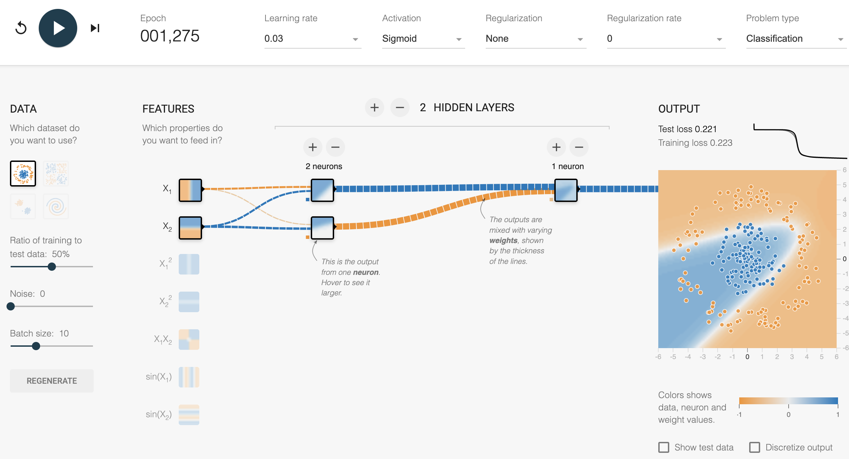
A neural Network Playground

Slide 32
Handcrafted Features as
Inputs for MLPs
Input Layer
Hidden Layer $1$
Hidden Layer $2$
Hidden Layer $3$
Output
Layer
x₁
$$P(C_{1})$$
x₂
x₃
$$P(C_{2})$$
Softmax Layer
x₄
Extracted Features as input
$$P(C_{3})$$
x₅
x₆
$$P(C_{4})$$
x₇
=
Σ
ϕ(.)
=
Σ

Slide 33
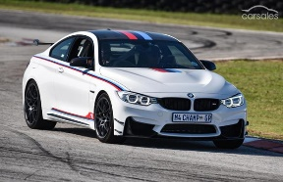
Feature Representations
Class Prediction
Pre-processing
Feature extraction
Feature selection
Input
Feature learner
Feature learning: Instead of design features,
let’s design feature learners

Slide 34
Image Classification
using MLP
Input Layer
Hidden Layer $1$
Hidden Layer $2$
Output
Layer
$$H$$
$$W$$
$H×W$ inputs in the input layer and $n$neurons in the Hidden Layer 1
Example: $1000×1000$ image
${10}^{3}$ hidden units: ${10}^{9}$ weight parameters !!!
Notes:
For example, when processing an image, If there are m inputs and n outputs, then matrix multiplication requires m×n parameters and the algorithms used in practice have O(m × n) runtime (per example).

Slide 35
Sparse Interactions
Input Layer
$$w_{1}$$
Hidden Layer $1$
Hidden Layer $2$
Output
Layer
$$w_{3}$$
$$w_{2}$$
$$w_{9}$$
$$w_{3}$$
$$w_{2}$$
$$w_{1}$$
$$w_{9}$$
$$w_{3}$$
$$w_{2}$$
$$w_{1}$$
$$H$$
$$w_{9}$$
$$w_{3}$$
$$w_{2}$$
$$w_{1}$$
$$w_{9}$$
$$W$$
Example: $1000×1000$ image
Filter size: $3×3$ ($w_{1},w_{2},w_{3},w_{4},w_{5},w_{6},w_{7},w_{8},w_{9}$): $9$ parameters!!!
Notes:
If we limit the number of connections each output may have to k, then the sparsely connected approach requires only k × n parameters and O(k × n) runtime.
This means that we need to store fewer parameters. It also means that computing the output requires fewer operations.

Slide 36
Outline
Convolutional Neural Networks (CNN)
Convolution Layer
Activation Function
Pooling Layer
Transposed Convolution (Deconv)
Un-pooling layer

Slide 37
Convolutional Neural
Networks
Convolutional neural networks are also known as Convolutional networks, CNNs, or ConvNets
Specialized for data having grid-like topology
1D grid – time series data
2D grid – Most successful on 2D image topology
3D grid – Videos

Slide 38
Typical CNN Layers
MLP
Loss function
Convolutional
layer
Non-linearity
layer
Pooling
layer
Input
…

Slide 39
Outline
Convolutional Neural Networks (CNN)
Convolution Layer
Activation Function
Pooling Layer
Transposed Convolution (Deconv)
Un-pooling layer

Slide 40
Convolution Layer
(Gray images)
Given a gray-scale input image $I$and a filter/kernel $K_{0}$,
Input image I$(5,5)$
Filter $K_{0}(3,3)$
0 | 0 | 0 | 1 | 0
2 | 1 | 2 | 2 | 0
2 | 0 | 2 | 0 | 1
1 | 0 | 0 | 0 | 1
1 | 1 | 0 | 2 | 1
-1 | 0 | 0
1 | 1 | -1
1 | -1 | -1
$$w_{1}$$ | $$w_{2}$$ | $$w_{3}$$
$$w_{4}$$ | $$w_{5}$$ | $$w_{6}$$
$$w_{7}$$ | $$w_{8}$$ | $$w_{9}$$

Slide 41
Convolution Layer
(Gray images)
0 | 0 | 0 | 1 | 0
2 | 1 | 2 | 2 | 0
2 | 0 | 2 | 0 | 1
1 | 0 | 0 | 0 | 1
1 | 1 | 0 | 2 | 1
Filter $K_{0}(:,:)$
Output $o_{0}(:,:)$
-1 | 0 | 0
1 | 1 | -1
1 | -1 | -1
1 | 0 | 1
-1 | 1 | 1
0 | 0 | -1
Input I$(:,:)$
Element wise multiplication
$$0×−1$$ | $$0×0$$ | $$0×0$$
$$2×1$$ | $$1×1$$ | $$2×−1$$
$$2×1$$ | $$0×−1$$ | $$2×−1$$
$$0$$ | $$0$$ | $$0$$
$$2$$ | $$1$$ | $$−2$$
$$2$$ | $$0$$ | $$−2$$
Sum
$$0+0+0+2+1+\left(−2\right)+2+0+\left(−2\right)=1$$

Slide 42
Convolution Layer
(RGB images)
Given an RGB input image $I$and a filter/kernel $K_{0}$,
Input image $I(5,5,3)$
Filter $K_{0}(3,3,3)$
R
0 | 0 | 0 | 1 | 0
2 | 1 | 2 | 2 | 0
2 | 0 | 2 | 0 | 1
1 | 0 | 0 | 0 | 1
1 | 1 | 0 | 2 | 1
G
2 | 1 | 0 | 1 | 2
0 | 1 | 0 | 1 | 1
1 | 2 | 0 | 0 | 2
1 | 1 | 1 | 2 | 1
2 | 0 | 0 | 0 | 2
-1 | 0 | 0
1 | 1 | -1
1 | -1 | -1
B
1 | 0 | 1
-1 | 1 | 1
0 | 0 | -1
2 | 1 | 0 | 1 | 2
0 | 1 | 0 | 1 | 1
1 | 2 | 0 | 0 | 2
1 | 1 | 1 | 2 | 1
2 | 0 | 0 | 0 | 2
-1 | -1 | -1
1 | 0 | -1
-1 | -1 | 1

Slide 43
Convolution Layer
(RGB images)
0 | 0 | 0 | 1 | 0
2 | 1 | 2 | 2 | 0
2 | 0 | 2 | 0 | 1
1 | 0 | 0 | 0 | 1
1 | 1 | 0 | 2 | 1
Filter $K_{0}(:,:,1)$
Input $I(:,:,1)$
-1 | 0 | 0
1 | 1 | -1
1 | -1 | -1
$$0$$ | $$0$$ | $$0$$
$$2$$ | $$1$$ | $$−2$$
$$2$$ | $$0$$ | $$−2$$
$$0×−1$$ | $$0×0$$ | $$0×0$$
$$2×1$$ | $$1×1$$ | $$2×−1$$
$$2×1$$ | $$0×−1$$ | $$2×−1$$
$$\sum{=1}$$
2 | 1 | 0 | 1 | 2
0 | 1 | 0 | 1 | 1
1 | 2 | 0 | 0 | 2
1 | 1 | 1 | 2 | 1
2 | 0 | 0 | 0 | 2
Filter $K_{0}(:,:,2)$
Input $I(:,:,2)$
1 | 0 | 1
-1 | 1 | 1
0 | 0 | -1
$$2×1$$ | $$1×0$$ | $$0×1$$
$$0×−1$$ | $$1×1$$ | $$0×1$$
$$1×0$$ | $$2×0$$ | $$0×−1$$
$$2$$ | $$0$$ | $$0$$
$$0$$ | $$1$$ | $$0$$
$$0$$ | $$0$$ | $$0$$
$$\sum{=3}$$
$$\sum{1+3+\left(−6\right)=−2}$$
2 | 1 | 0 | 1 | 2
0 | 1 | 0 | 1 | 1
1 | 2 | 0 | 0 | 2
1 | 1 | 1 | 2 | 1
2 | 0 | 0 | 0 | 2
Filter $K_{0}(:,:,3)$
Input $I(:,:,3)$
$$−2$$ | $$−1$$ | $$0$$
$$0$$ | $$0$$ | $$0$$
$$−1$$ | $$−2$$ | $$0$$
-1 | -1 | -1
1 | 0 | -1
-1 | -1 | 1
$$2×−1$$ | $$1×−1$$ | $$0×−1$$
$$0×1$$ | $$1×0$$ | $$0×−1$$
$$1×−1$$ | $$2×−1$$ | $$0×1$$
$$\sum{=−6}$$

Slide 44
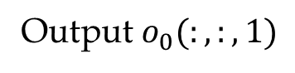
Convolution Layer
(RGB images)
0 | 0 | 0 | 1 | 0
2 | 1 | 2 | 2 | 0
2 | 0 | 2 | 0 | 1
1 | 0 | 0 | 0 | 1
1 | 1 | 0 | 2 | 1
Filter $K_{0}(:,:,1)$
Input $I(:,:,1)$
-1 | 0 | 0
1 | 1 | -1
1 | -1 | -1
2 | 1 | 0 | 1 | 2
0 | 1 | 0 | 1 | 1
1 | 2 | 0 | 0 | 2
1 | 1 | 1 | 2 | 1
2 | 0 | 0 | 0 | 2
Filter $K_{0}(:,:,2)$
Input $I(:,:,2)$
1 | 0 | 1
-1 | 1 | 1
0 | 0 | -1
-2 | 0 | 1
-1 | 1 | 1
0 | 0 | -1
2 | 1 | 0 | 1 | 2
0 | 1 | 0 | 1 | 1
1 | 2 | 0 | 0 | 2
1 | 1 | 1 | 2 | 1
2 | 0 | 0 | 0 | 2
Filter $K_{0}(:,:,3)$
Input $I(:,:,3)$
-1 | -1 | -1
1 | 0 | -1
-1 | -1 | 1

Slide 45
Variants of the Basic Convolution Function
Stride
is the amount of down-sampling
Zero padding
avoids layer-to-layer shrinking
Unshared convolution
Like convolution but without sharing
Tiled convolution
Cycle between shared parameter groups

Slide 46
Convolution with Stride 1
0 | 0 | 0 | 1 | 0
2 | 1 | 2 | 2 | 0
2 | 0 | 2 | 0 | 1
1 | 0 | 0 | 0 | 1
1 | 1 | 0 | 2 | 1
Filter $K_{0}(:,:,1)$
Input $I(:,:,1)$
-1 | 0 | 0
1 | 1 | -1
1 | -1 | -1
2 | 1 | 0 | 1 | 2
0 | 1 | 0 | 1 | 1
1 | 2 | 0 | 0 | 2
1 | 1 | 1 | 2 | 1
2 | 0 | 0 | 0 | 2
Filter $K_{0}(:,:,2)$
Input $I(:,:,2)$
1 | 0 | 1
-1 | 1 | 1
0 | 0 | -1
1 | 0 | 1
-1 | 1 | 1
0 | 0 | -1
2 | 1 | 0 | 1 | 2
0 | 1 | 0 | 1 | 1
1 | 2 | 0 | 0 | 2
1 | 1 | 1 | 2 | 1
2 | 0 | 0 | 0 | 2
Filter $K_{0}(:,:,3)$
Input $I(:,:,3)$
-1 | -1 | -1
1 | 0 | -1
-1 | -1 | 1

Slide 47
Convolution with Stride 2
0 | 0 | 0 | 1 | 0
2 | 1 | 2 | 2 | 0
2 | 0 | 2 | 0 | 1
1 | 0 | 0 | 0 | 1
1 | 1 | 0 | 2 | 1
Filter $K_{0}(:,:,1)$
Input $I(:,:,1)$
-1 | 0 | 0
1 | 1 | -1
1 | -1 | -1
2 | 1 | 0 | 1 | 2
0 | 1 | 0 | 1 | 1
1 | 2 | 0 | 0 | 2
1 | 1 | 1 | 2 | 1
2 | 0 | 0 | 0 | 2
Filter $K_{0}(:,:,2)$
Input $I(:,:,2)$
1 | 0 | 1
-1 | 1 | 1
0 | 0 | -1
1 | 0
-1 | 1
shrinking
2 | 1 | 0 | 1 | 2
0 | 1 | 0 | 1 | 1
1 | 2 | 0 | 0 | 2
1 | 1 | 1 | 2 | 1
2 | 0 | 0 | 0 | 2
Filter $K_{0}(:,:,3)$
Input $I(:,:,3)$
-1 | -1 | -1
1 | 0 | -1
-1 | -1 | 1

Slide 48
Variants of the Basic Convolution Function
Stride
is the amount of down-sampling
Zero padding
avoids layer-to-layer shrinking
Unshared convolution
Like convolution but without sharing
Tiled convolution
Cycle between shared parameter groups

Slide 49
Convolution with
Zero Padding
Convolution without Zero Padding results in shrinking
Why use padding?
Improves performance
Without Zero Padding the inputs,
the size of the volumes would reduce by a small amount after each CONV, and
the information at the borders would be “washed away” too quickly.

Slide 50
0 | 0 | 0 | 0 | 0 | 0 | 0
0 | 0 | 0 | 0 | 1 | 0 | 0
0 | 2 | 1 | 2 | 2 | 0 | 0
0 | 2 | 0 | 2 | 0 | 1 | 0
0 | 1 | 0 | 0 | 0 | 1 | 0
0 | 1 | 1 | 0 | 2 | 1 | 0
0 | 0 | 0 | 0 | 0 | 0 | 0
Filter $K_{0}(:,:,1)$
-1 | 0 | 0
1 | 1 | -1
1 | -1 | -1
Input $I(:,:,1)$
0 | 0 | 0 | 0 | 0 | 0 | 0
0 | 2 | 1 | 0 | 1 | 2 | 0
0 | 0 | 1 | 0 | 1 | 1 | 0
0 | 1 | 2 | 0 | 0 | 2 | 0
0 | 1 | 1 | 1 | 2 | 1 | 0
0 | 2 | 0 | 0 | 0 | 2 | 0
0 | 0 | 0 | 0 | 0 | 0 | 0
Output $o_{0}(:,:,1)$
Filter $K_{0}(:,:,2)$
2 | 1 | 0 | 1 | 2
0 | 1 | 0 | 1 | 1
1 | 2 | 0 | 0 | 2
1 | 1 | 1 | 2 | 1
2 | 0 | 0 | 0 | 2
1 | 0 | 1
-1 | 1 | 1
0 | 0 | -1
Input $I(:,:,2)$
Convolution with Zero Padding (output is $5×5$)
0 | 0 | 0 | 0 | 0 | 0 | 0
0 | 2 | 1 | 0 | 1 | 2 | 0
0 | 0 | 1 | 0 | 1 | 1 | 0
0 | 1 | 2 | 0 | 0 | 2 | 0
0 | 1 | 1 | 1 | 2 | 1 | 0
0 | 2 | 0 | 0 | 0 | 2 | 0
0 | 0 | 0 | 0 | 0 | 0 | 0
Filter$K_{0}(:,:,3)$
-1 | -1 | -1
1 | 0 | -1
-1 | -1 | 1
Input I$(:,:,3)$

Slide 51
Variants of the Basic Convolution Function
Stride
is the amount of down-sampling
Zero padding
avoids layer-to-layer shrinking
Unshared convolution
Like convolution but without sharing
Tiled convolution
Cycle between shared parameter groups

Slide 52
Unshared Convolution
0 | 0 | 0 | 1 | 0
2 | 1 | 2 | 2 | 0
2 | 0 | 2 | 0 | 1
1 | 0 | 0 | 0 | 1
1 | 1 | 0 | 2 | 1
Filter $K_{0}(:,:,1)$
-1 | 0 | 0
1 | 1 | -1
1 | -1 | -1
Input $I(:,:,1)$
Local connection: like convolution, but no sharing
2 | 1 | 0 | 1 | 2
0 | 1 | 0 | 1 | 1
1 | 2 | 0 | 0 | 2
1 | 1 | 1 | 2 | 1
2 | 0 | 0 | 0 | 2
Filter $K_{0}(:,:,2)$
1 | 0 | 1
-1 | 1 | 1
0 | 0 | -1
1 | 0 | 1
-1 | 1 | 1
0 | 0 | -1
Input $I(:,:,2)$
2 | 1 | 0 | 1 | 2
0 | 1 | 0 | 1 | 1
1 | 2 | 0 | 0 | 2
1 | 1 | 1 | 2 | 1
2 | 0 | 0 | 0 | 2
Filter $K_{0}(:,:,3)$
-1 | -1 | -1
1 | 0 | -1
-1 | -1 | 1
Input $I(:,:,3)$

Slide 53
Unshared Convolution
0 | 0 | 0 | 1 | 0
2 | 1 | 2 | 2 | 0
2 | 0 | 2 | 0 | 1
1 | 0 | 0 | 0 | 1
1 | 1 | 0 | 2 | 1
Filter $K_{1}(:,:,1)$
1 | 0 | -1
-1 | 1 | -1
0 | 1 | 1
Input $I(:,:,1)$
Local connection: like convolution, but no sharing
2 | 1 | 0 | 1 | 2
0 | 1 | 0 | 1 | 1
1 | 2 | 0 | 0 | 2
1 | 1 | 1 | 2 | 1
2 | 0 | 0 | 0 | 2
Filter $K_{1}(:,:,2)$
1 | 0 | 0
1 | -1 | -1
1 | 0 | -1
1 | 0 | 1
-1 | 1 | 1
0 | 0 | -1
Input $I(:,:,2)$
2 | 1 | 0 | 1 | 2
0 | 1 | 0 | 1 | 1
1 | 2 | 0 | 0 | 2
1 | 1 | 1 | 2 | 1
2 | 0 | 0 | 0 | 2
Filter $K_{1}(:,:,3)$
0 | -1 | 1
0 | 0 | -1
1 | -1 | 0
Input $I(:,:,3)$

Slide 54
Unshared Convolution
0 | 0 | 0 | 1 | 0
2 | 1 | 2 | 2 | 0
2 | 0 | 2 | 0 | 1
1 | 0 | 0 | 0 | 1
1 | 1 | 0 | 2 | 1
Filter $K_{2}(:,:,1)$
-1 | 0 | -1
-1 | -1 | -1
1 | -1 | 1
Input $I(:,:,1)$
Local connection: like convolution, but no sharing
2 | 1 | 0 | 1 | 2
0 | 1 | 0 | 1 | 1
1 | 2 | 0 | 0 | 2
1 | 1 | 1 | 2 | 1
2 | 0 | 0 | 0 | 2
Filter $K_{2}(:,:,2)$
1 | 1 | 1
-1 | -1 | -1
0 | 0 | -1
1 | 0 | 1
-1 | 1 | 1
0 | 0 | -1
Input $I(:,:,2)$
2 | 1 | 0 | 1 | 2
0 | 1 | 0 | 1 | 1
1 | 2 | 0 | 0 | 2
1 | 1 | 1 | 2 | 1
2 | 0 | 0 | 0 | 2
Filter $K_{2}(:,:,3)$
0 | -1 | 1
0 | -1 | -1
-1 | 1 | 0
Input $I(:,:,3)$

Slide 55
Unshared Convolution
0 | 0 | 0 | 1 | 0
2 | 1 | 2 | 2 | 0
2 | 0 | 2 | 0 | 1
1 | 0 | 0 | 0 | 1
1 | 1 | 0 | 2 | 1
Filter $K_{3}(:,:,1)$
-1 | 1 | -1
0 | 0 | -1
0 | 1 | 1
Input $I(:,:,1)$
Local connection: like convolution, but no sharing
2 | 1 | 0 | 1 | 2
0 | 1 | 0 | 1 | 1
1 | 2 | 0 | 0 | 2
1 | 1 | 1 | 2 | 1
2 | 0 | 0 | 0 | 2
Filter $K_{3}(:,:,2)$
1 | -1 | 0
0 | -1 | -1
0 | -1 | 1
1 | 0 | 1
-1 | 1 | 1
0 | 0 | -1
Input $I(:,:,2)$
2 | 1 | 0 | 1 | 2
0 | 1 | 0 | 1 | 1
1 | 2 | 0 | 0 | 2
1 | 1 | 1 | 2 | 1
2 | 0 | 0 | 0 | 2
Filter $K_{3}(:,:,3)$
1 | -1 | -1
1 | 1 | -1
-1 | -1 | 0
Input $I(:,:,3)$

Slide 56
Unshared Convolution
0 | 0 | 0 | 1 | 0
2 | 1 | 2 | 2 | 0
2 | 0 | 2 | 0 | 1
1 | 0 | 0 | 0 | 1
1 | 1 | 0 | 2 | 1
Filter $K_{4}(:,:,1)$
0 | 0 | 1
1 | 0 | -1
0 | -1 | -1
Input $I(:,:,1)$
Local connection: like convolution, but no sharing
2 | 1 | 0 | 1 | 2
0 | 1 | 0 | 1 | 1
1 | 2 | 0 | 0 | 2
1 | 1 | 1 | 2 | 1
2 | 0 | 0 | 0 | 2
Filter $K_{4}(:,:,2)$
0 | -1 | 1
0 | -1 | 0
1 | -1 | -1
1 | 0 | 1
-1 | 1 | 1
0 | 0 | -1
Input $I(:,:,2)$
2 | 1 | 0 | 1 | 2
0 | 1 | 0 | 1 | 1
1 | 2 | 0 | 0 | 2
1 | 1 | 1 | 2 | 1
2 | 0 | 0 | 0 | 2
Filter $K_{4}(:,:,3)$
-1 | 1 | 1
0 | -1 | 1
1 | 1 | 0
Input $I(:,:,3)$

Slide 57
Unshared Convolution
0 | 0 | 0 | 1 | 0
2 | 1 | 2 | 2 | 0
2 | 0 | 2 | 0 | 1
1 | 0 | 0 | 0 | 1
1 | 1 | 0 | 2 | 1
Filter $K_{5}(:,:,1)$
1 | 0 | -1
1 | 1 | -1
0 | 1 | 1
Input $I(:,:,1)$
Local connection: like convolution, but no sharing
2 | 1 | 0 | 1 | 2
0 | 1 | 0 | 1 | 1
1 | 2 | 0 | 0 | 2
1 | 1 | 1 | 2 | 1
2 | 0 | 0 | 0 | 2
Filter $K_{5}(:,:,2)$
1 | 0 | 0
-1 | -1 | -1
1 | 0 | -1
1 | 0 | 1
-1 | 1 | 1
0 | 0 | -1
Input $I(:,:,2)$
2 | 1 | 0 | 1 | 2
0 | 1 | 0 | 1 | 1
1 | 2 | 0 | 0 | 2
1 | 1 | 1 | 2 | 1
2 | 0 | 0 | 0 | 2
Filter $K_{5}(:,:,3)$
1 | -1 | 1
0 | -1 | -1
1 | 1 | 0
Input $I(:,:,3)$

Slide 58
Unshared Convolution
0 | 0 | 0 | 1 | 0
2 | 1 | 2 | 2 | 0
2 | 0 | 2 | 0 | 1
1 | 0 | 0 | 0 | 1
1 | 1 | 0 | 2 | 1
Filter $K_{6}(:,:,1)$
1 | 0 | 1
-1 | 1 | -1
0 | 1 | 0
Input $I(:,:,1)$
Local connection: like convolution, but no sharing
2 | 1 | 0 | 1 | 2
0 | 1 | 0 | 1 | 1
1 | 2 | 0 | 0 | 2
1 | 1 | 1 | 2 | 1
2 | 0 | 0 | 0 | 2
Filter $K_{6}(:,:,2)$
1 | 0 | -1
-1 | 0 | -1
1 | 1 | -1
1 | 0 | 1
-1 | 1 | 1
0 | 0 | -1
Input $I(:,:,2)$
2 | 1 | 0 | 1 | 2
0 | 1 | 0 | 1 | 1
1 | 2 | 0 | 0 | 2
1 | 1 | 1 | 2 | 1
2 | 0 | 0 | 0 | 2
Filter $K_{6}(:,:,3)$
0 | -1 | -1
-1 | 0 | -1
0 | -1 | 1
Input $I(:,:,3)$

Slide 59
Unshared Convolution
0 | 0 | 0 | 1 | 0
2 | 1 | 2 | 2 | 0
2 | 0 | 2 | 0 | 1
1 | 0 | 0 | 0 | 1
1 | 1 | 0 | 2 | 1
Filter $K_{7}(:,:,1)$
1 | 0 | -1
1 | 0 | -1
-1 | 1 | 1
Input $I(:,:,1)$
Local connection: like convolution, but no sharing
2 | 1 | 0 | 1 | 2
0 | 1 | 0 | 1 | 1
1 | 2 | 0 | 0 | 2
1 | 1 | 1 | 2 | 1
2 | 0 | 0 | 0 | 2
Filter $K_{7}(:,:,2)$
1 | -1 | 0
1 | -1 | -1
1 | 0 | -1
1 | 0 | 1
-1 | 1 | 1
0 | 0 | -1
Input $I(:,:,2)$
2 | 1 | 0 | 1 | 2
0 | 1 | 0 | 1 | 1
1 | 2 | 0 | 0 | 2
1 | 1 | 1 | 2 | 1
2 | 0 | 0 | 0 | 2
Filter $K_{7}(:,:,3)$
0 | -1 | 1
-1 | 1 | -1
1 | 0 | 0
Input $I(:,:,3)$

Slide 60
Unshared Convolution
0 | 0 | 0 | 1 | 0
2 | 1 | 2 | 2 | 0
2 | 0 | 2 | 0 | 1
1 | 0 | 0 | 0 | 1
1 | 1 | 0 | 2 | 1
Filter $K_{8}(:,:,1)$
1 | 0 | -1
1 | 1 | -1
0 | 1 | 1
Input $I(:,:,1)$
Local connection: like convolution, but no sharing
2 | 1 | 0 | 1 | 2
0 | 1 | 0 | 1 | 1
1 | 2 | 0 | 0 | 2
1 | 1 | 1 | 2 | 1
2 | 0 | 0 | 0 | 2
Filter $K_{8}(:,:,2)$
1 | -1 | 0
1 | 1 | 1
1 | 0 | -1
1 | 0 | 1
-1 | 1 | 1
0 | 0 | -1
Input $I(:,:,2)$
2 | 1 | 0 | 1 | 2
0 | 1 | 0 | 1 | 1
1 | 2 | 0 | 0 | 2
1 | 1 | 1 | 2 | 1
2 | 0 | 0 | 0 | 2
Filter $K_{8}(:,:,3)$
0 | -1 | -1
1 | 1 | -1
1 | -1 | 0
Input $I(:,:,3)$

Slide 61
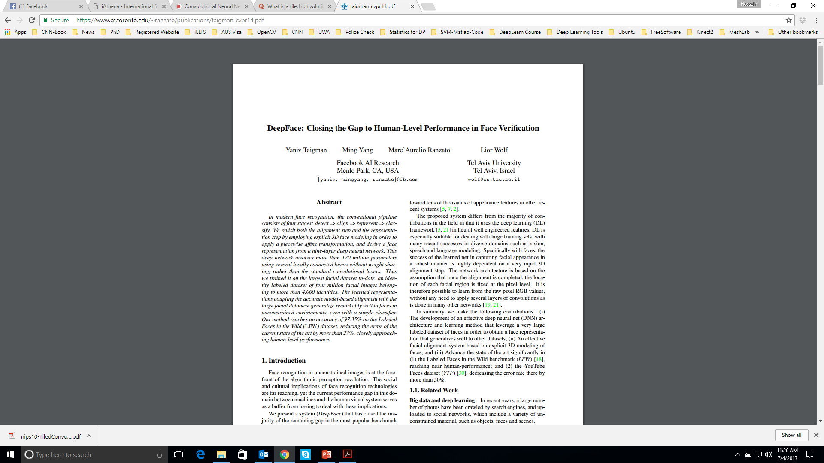
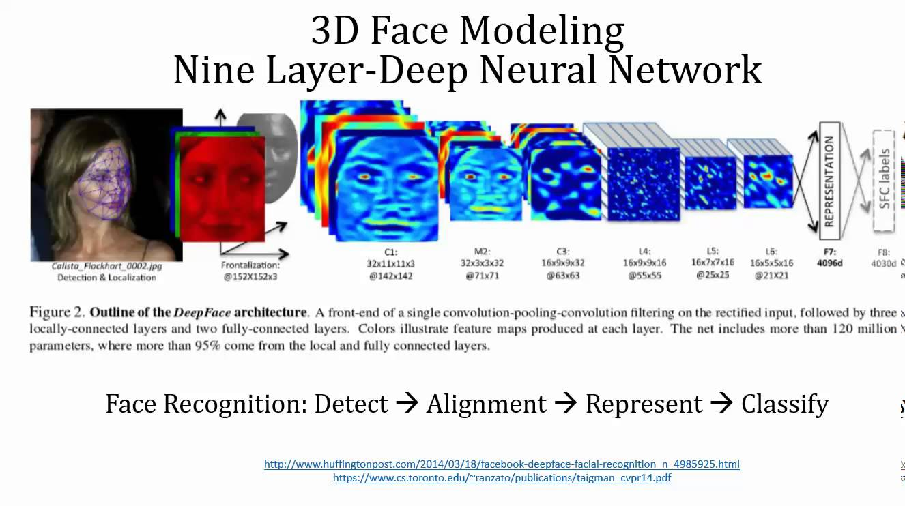
Unshared Convolution
Face recognition problem is one of the application of unshared convolution.
Different regions of an aligned image have different local statistics.
Notes:
Face recognition problem is one of the application of unshared convolution. Different regions of an aligned image have different local statistics.
For example, areas between the eyes and the eyebrows exhibit very different appearance and have much higher discrimination ability compared to areas between the nose and the mouth.
The use of local layers does not affect the computational burden of feature extraction, but does affect the number of parameters subject to training.
The subsequent layers (L4, L5 and L6) are instead locally connected, like a convolutional layer they apply a filter bank, but every location in the feature map learns a different set of filters.
(press key) For more details, I refer you to this paper.

Slide 62
Variants of the Basic Convolution Function
Stride
is the amount of down-sampling
Zero padding
avoids layer-to-layer shrinking
Unshared convolution
Like convolution but without sharing
Tiled convolution
Cycle between shared parameter groups

Slide 63
Tiled Convolution
A compromise between convolutional layer and unshared convolution
Cycle between shared parameter groups
A set of filters (e.g. 2)
Filter $K_{0}(:,:)$
-1 | 0 | 0
1 | 1 | -1
1 | -1 | -1
0 | 0 | 0 | 1 | 0
2 | 1 | 2 | 2 | 0
2 | 0 | 2 | 0 | 1
1 | 0 | 0 | 0 | 1
1 | 1 | 0 | 2 | 1
Input $I(:,:)$
Filter $K_{1}(:,:)$
1 | 0 | 1
-1 | 1 | 1
0 | 0 | -1

Slide 64
Tiled Convolution
A set of 2 filters
Filter $K_{0}(:,:)$
Filter $K_{1}(:,:)$
-1 | 0 | 0
1 | 1 | -1
1 | -1 | -1
1 | 0 | 1
-1 | 1 | 1
0 | 0 | -1
0 | 0 | 0 | 1 | 0
2 | 1 | 2 | 2 | 0
2 | 0 | 2 | 0 | 1
1 | 0 | 0 | 0 | 1
1 | 1 | 0 | 2 | 1
Filter $K_{0}(:,:)$
Output $o_{0}(:,:)$
-1 | 0 | 0
1 | 1 | -1
1 | -1 | -1
1 | 0 | 1
-1 | 1 | 1
0 | 0 | -1
Input $I(:,:)$

Slide 65
Tiled Convolution
A set of 2 filters
Filter $K_{0}(:,:)$
Filter $K_{1}(:,:)$
-1 | 0 | 0
1 | 1 | -1
1 | -1 | -1
1 | 0 | 1
-1 | 1 | 1
0 | 0 | -1
0 | 0 | 0 | 1 | 0
2 | 1 | 2 | 2 | 0
2 | 0 | 2 | 0 | 1
1 | 0 | 0 | 0 | 1
1 | 1 | 0 | 2 | 1
Filter $K_{1}(:,:)$
Output $o_{0}(:,:)$
1 | 0 | 1
-1 | 1 | 1
0 | 0 | -1
1 | 0 | 1
-1 | 1 | 1
0 | 0 | -1
Input $I(:,:)$

Slide 66
Tiled Convolution
A set of 2 filters
Filter $K_{0}(:,:)$
Filter $K_{1}(:,:)$
-1 | 0 | 0
1 | 1 | -1
1 | -1 | -1
1 | 0 | 1
-1 | 1 | 1
0 | 0 | -1
0 | 0 | 0 | 1 | 0
2 | 1 | 2 | 2 | 0
2 | 0 | 2 | 0 | 1
1 | 0 | 0 | 0 | 1
1 | 1 | 0 | 2 | 1
Filter $K_{0}(:,:)$
Output $o_{0}(:,:)$
-1 | 0 | 0
1 | 1 | -1
1 | -1 | -1
1 | 0 | 1
-1 | 1 | 1
0 | 0 | -1
Input $I(:,:)$
And so on …

Slide 67
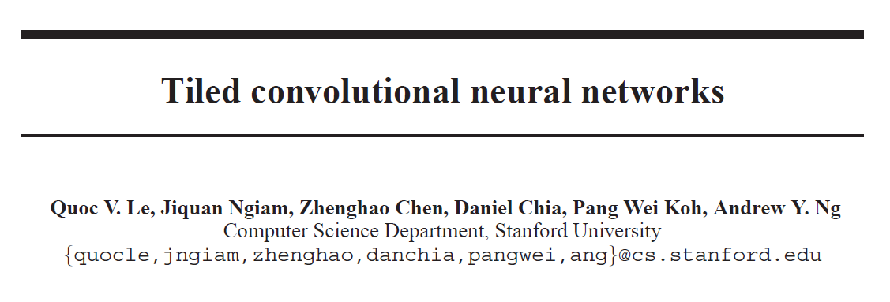
Tiled Convolution
It has shown that this model learn a more complex range of invariances, such as scale and rotational invariance beyond translational invariance.
Notes:
For more details, I refer you to this paper.

Slide 68
Typical CNN Layers
MLP
Loss function
Convolutional
layer
Non-linearity
layer
Pooling
layer
Input
…

Slide 69
Outline
Convolutional Neural Networks (CNN)
Convolution Layer
Activation Function
Pooling Layer
Transposed Convolution (Deconv)
Un-pooling layer

Slide 70
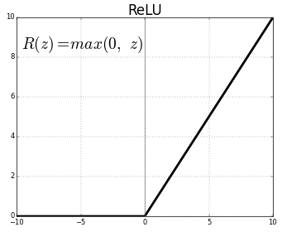
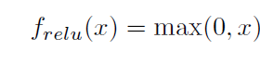
Activation Functions
Rectifier Linear Unit (ReLU)
ReLU is a simple activation function
Quick computation
Most popular activation function for deep networks
Avoids saturation issues and makes learning faster
Variants:
Noisy ReLU
Leaky ReLU
Parametric Linear Units
Randomized Leaky Rectier Linear Unit
Exponential Linear Units
Notes:
ReLU is a simple activation function which is of special practical importance because of it's quick computation.
Most popular activation function for deep networks as of 2015, avoids saturation issues and makes learning faster
A ReLU function maps the input to a 0 if it is negative and keeps its value unchanged if it is positive.
The popularity and effectiveness of ReLU has lead to a number of its variants including:

Slide 71

Activation Functions
Output $o_{0}(:,:,1)$
2 | 1 | 0 | 1 | -2
0 | -1 | 0 | 1 | 1
1 | 2 | 0 | 0 | 2
1 | 1 | -1 | -2 | 1
2 | 0 | 0 | 0 | 2
2 | 1 | 0 | 1 | 0
0 | 0 | 0 | 1 | 1
1 | 2 | 0 | 0 | 2
1 | 1 | 0 | 0 | 1
2 | 0 | 0 | 0 | 2

Slide 72
Typical CNN Layers
MLP
Loss function
Convolutional
layer
Non-linearity
layer
Pooling
layer
Input
…

Slide 73
Outline
Convolutional Neural Networks (CNN)
Convolution Layer
Activation Function
Pooling Layer
Transposed Convolution (Deconv)
Un-pooling layer

Slide 74
Pooling Layer
Replaces the output of the network at a certain location with a summary statistic of the nearby outputs.
Reduces computation for upper layers
Non-linear down-sampling
Provides translation invariance
Useful property, if we care more about whether some feature is present than exactly where it is, thus adds robustness to position
Variants:
Max pooling (popular): reports the maximum output within a rectangular neighborhood
Average pooling: reports the average output
L2 norm of neighbourhood
Notes:
The pooling function replaces the output of the network at a certain location with a summary statistic of the nearby outputs.
Reduces computation for upper layers by reporting summary statistics (only with stride > 1)
Non-linear down-sampling to simplify the information in output from convolutional layer.
Pooling helps to make the representation become approximately invariant to small translations of the input. Invariance to translation means that if we translate the input by a small amount, the values of most of the pooled outputs do not change.

Slide 75
Pooling Layer
Output $o_{0}(:,:,1)$
2 | 1 | 0 | 1 | -2
0 | -1 | 0 | 1 | 1
1 | 2 | 0 | 0 | 2
1 | 1 | -1 | -2 | 1
2 | 0 | 0 | 0 | 2
2 | 1 | 0 | 1 | 0
0 | 0 | 0 | 1 | 1
1 | 2 | 0 | 0 | 2
1 | 1 | 0 | 0 | 1
2 | 0 | 0 | 0 | 2

Slide 76
Pooling Layer
The maximum activation is chosen from the selected block of values
Similar to the convolution layer, we need to specify the size of pooled region and the stride.
If the size of pooled region is given by $f×f$, with a stride $s$, the size of the output feature map can be given by:
Stride 1, size of pooled region $3×3$
3 | 0 | 0 | 1 | 0
2 | 8 | 5 | 2 | 0
2 | 0 | 2 | 0 | 1
6 | 0 | 0 | 0 | 1
1 | 1 | 0 | 5 | 1
8 | 8 | 5
8 | 8 | 5
6 | 5 | 5
Input features map
Output after Max-Pooling

Slide 77
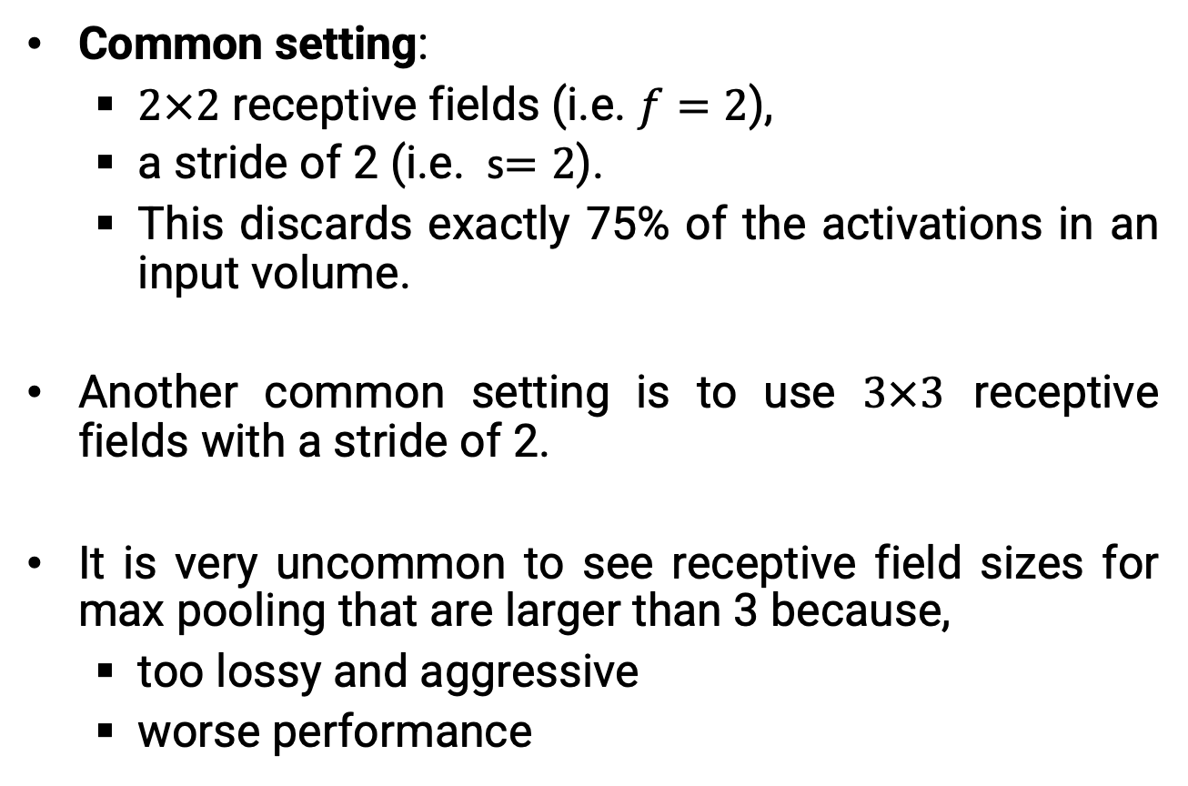
Pooling Layer
Common setting:
$2×2$ receptive fields (i.e. $f=2$),
a stride of 2 (i.e. s$=2$).
This discards exactly 75% of the activations in an input volume.
Another common setting is to use $3×3$ receptive fields with a stride of 2.
It is very uncommon to see receptive field sizes for max pooling that are larger than 3 because,
too lossy and aggressive
worse performance
Notes:
The most common setting is to use max-pooling with 2x2 receptive fields (i.e. F=2), and with a stride of 2 (i.e. S=2). Note that this discards exactly 75% of the activations in an input volume (due to downsampling by 2 in both width and height).
Another slightly less common setting is to use 3x3 receptive fields with a stride of 2.
It is very uncommon to see receptive field sizes for max pooling that are larger than 3 because the pooling is then too lossy and aggressive. This usually leads to worse performance.

Slide 78
Typical CNN Layers
Putting It All Together!
MLP
Loss function
Convolutional
layer
Non-linearity
layer
Pooling
layer
Input
…

Slide 79

VGGNET
(Example)
Number of
filters/channels
Notes:
Convolution with a single kernel can only extract one kind of feature, albeit at many spatial locations. Usually we want each layer of our network to extract many kinds of features, at many locations.

Slide 80
Multiple Filters-Multiple Outputs
0 | 0 | 0 | 1 | 0
2 | 1 | 2 | 2 | 0
2 | 0 | 2 | 0 | 1
1 | 0 | 0 | 0 | 1
1 | 1 | 0 | 2 | 1
Filter $K_{0}(:,:,1)$
Output $o_{0}(:,:,1)$
-1 | 0 | 0
1 | 1 | -1
1 | -1 | -1
1 | 0 | 1
-1 | 1 | 1
0 | 0 | -1
Input $I(:,:,1)$
2 | 1 | 0 | 1 | 2
0 | 1 | 0 | 1 | 1
1 | 2 | 0 | 0 | 2
1 | 1 | 1 | 2 | 1
2 | 0 | 0 | 0 | 2
Filter $K_{0}(:,:,2)$
1 | 0 | 1
-1 | 1 | 1
0 | 0 | -1
Input $I(:,:,2)$
2 | 1 | 0 | 1 | 2
0 | 1 | 0 | 1 | 1
1 | 2 | 0 | 0 | 2
1 | 1 | 1 | 2 | 1
2 | 0 | 0 | 0 | 2
Filter $K_{0}(:,:,3)$
-1 | -1 | -1
1 | 0 | -1
-1 | -1 | 1
Input $I(:,:,3)$

Slide 81
Multiple Filters-Multiple Outputs
0 | 0 | 0 | 1 | 0
2 | 1 | 2 | 2 | 0
2 | 0 | 2 | 0 | 1
1 | 0 | 0 | 0 | 1
1 | 1 | 0 | 2 | 1
Filter $K_{1}(:,:,1)$
Output $o_{0}(:,:,1)$
1 | 0 | 0
-1 | -1 | -1
1 | 0 | 1
1 | 0 | 1
-1 | 1 | 1
0 | 0 | -1
Input $I(:,:,1)$
Output $o_{0}(:,:,2)$
2 | 1 | 0 | 1 | 2
0 | 1 | 0 | 1 | 1
1 | 2 | 0 | 0 | 2
1 | 1 | 1 | 2 | 1
2 | 0 | 0 | 0 | 2
Filter $K_{1}(:,:,2)$
-1 | 0 | 1
1 | -1 | 1
1 | 0 | 1
1 | -1 | -1
1 | 1 | 0
1 | -1 | -1
Input $I(:,:,2)$
2 | 1 | 0 | 1 | 2
0 | 1 | 0 | 1 | 1
1 | 2 | 0 | 0 | 2
1 | 1 | 1 | 2 | 1
2 | 0 | 0 | 0 | 2
Filter $K_{1}(:,:,3)$
-1 | 1 | -1
-1 | -1 | -1
-1 | 1 | -1
Input $I(:,:,3)$

Slide 82
Multiple Filters-Multiple Outputs
0 | 0 | 0 | 1 | 0
2 | 1 | 2 | 2 | 0
2 | 0 | 2 | 0 | 1
1 | 0 | 0 | 0 | 1
1 | 1 | 0 | 2 | 1
Filter $K_{2}(:,:,1)$
Output $o_{0}(:,:,1)$
0 | -1 | 0
-1 | 0 | 0
-1 | 0 | 1
1 | 0 | 1
-1 | 1 | 1
0 | 0 | -1
Input $I(:,:,1)$
Output $o_{0}(:,:,2)$
2 | 1 | 0 | 1 | 2
0 | 1 | 0 | 1 | 1
1 | 2 | 0 | 0 | 2
1 | 1 | 1 | 2 | 1
2 | 0 | 0 | 0 | 2
Filter $K_{2}(:,:,2)$
-1 | 0 | 1
1 | -1 | 1
1 | 0 | 1
1 | -1 | -1
0 | -1 | 0
-1 | 0 | -1
Input $I(:,:,2)$
Output $o_{0}(:,:,3)$
1 | 0 | 1
-1 | 1 | 1
0 | 0 | -1
2 | 1 | 0 | 1 | 2
0 | 1 | 0 | 1 | 1
1 | 2 | 0 | 0 | 2
1 | 1 | 1 | 2 | 1
2 | 0 | 0 | 0 | 2
Filter $K_{2}(:,:,3)$
0 | 1 | -1
1 | 0 | -1
0 | 1 | -1
Input $I(:,:,3)$
…
E.g. 3 filters 3 outputs

Slide 83
VGGNET
(Example)
Number of
filters/channels
Notes:
Convolution with a single kernel can only extract one kind of feature, albeit at many spatial locations. Usually we want each layer of our network to extract many kinds of features, at many locations.

Slide 84
Outline
Convolutional Neural Networks (CNN)
Convolution Layer
Activation Function
Pooling Layer
Transposed Convolution (Deconv)
Un-pooling layer

Slide 85
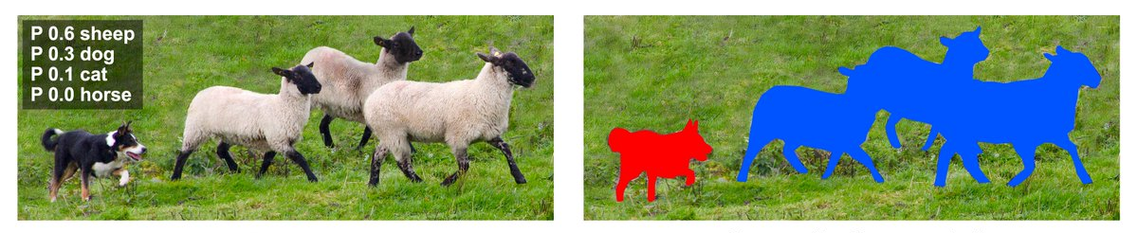
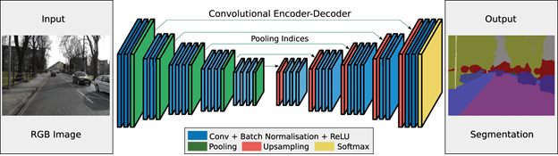
Semantic Segmentation

Slide 86
Outline
Convolutional Neural Networks (CNN)
Convolution Layer
Activation Function
Pooling Layer
Transposed Convolution (Deconv)
Un-pooling layer

Slide 87
Transposed Convolution
The CNN layers we have seen so far, such as convolutional layers and pooling layers, typically reduce (downsample) the spatial dimensions (height and width) of the input or keep them unchanged.
In semantic segmentation that classifies at pixel-level, it will be convenient if the spatial dimensions of the input and output are the same.

Slide 88
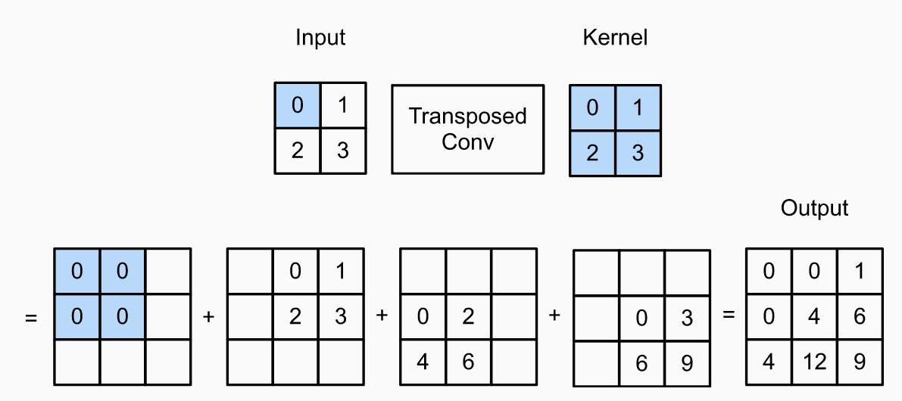
Transposed Convolution (Example)
Transposed convolution with a 2×2 kernel is computed for a 2×2 input.

Slide 89
Outline
Convolutional Neural Networks (CNN)
Convolution Layer
Activation Function
Pooling Layer
Transposed Convolution (Deconv)
Un-pooling layer

Slide 90
Un-Pooling Layer
Max-unpooling is an upsampling procedure
Max pooling is an non-invertable operation, instead we obtain an approximation
Approaches include:
Nearest-Neighbor
Bed of Nails
Max Unpooling

Slide 91
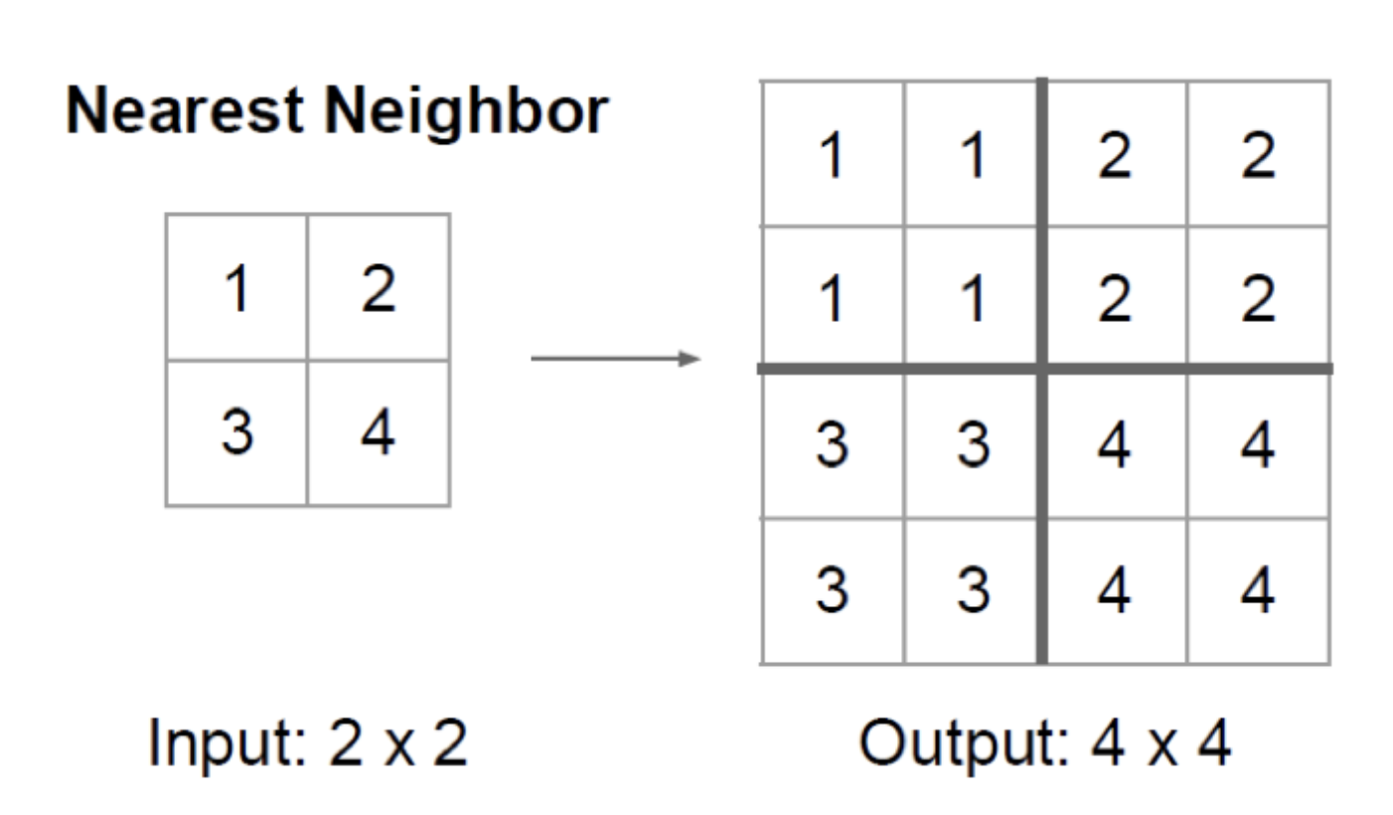
Un-Pooling Layer
(Nearest-Neighbor)
Although its simplicity, the problem of this approach is that the output structure becomes blocky as all pixels in each subregion have the same value.

Slide 92
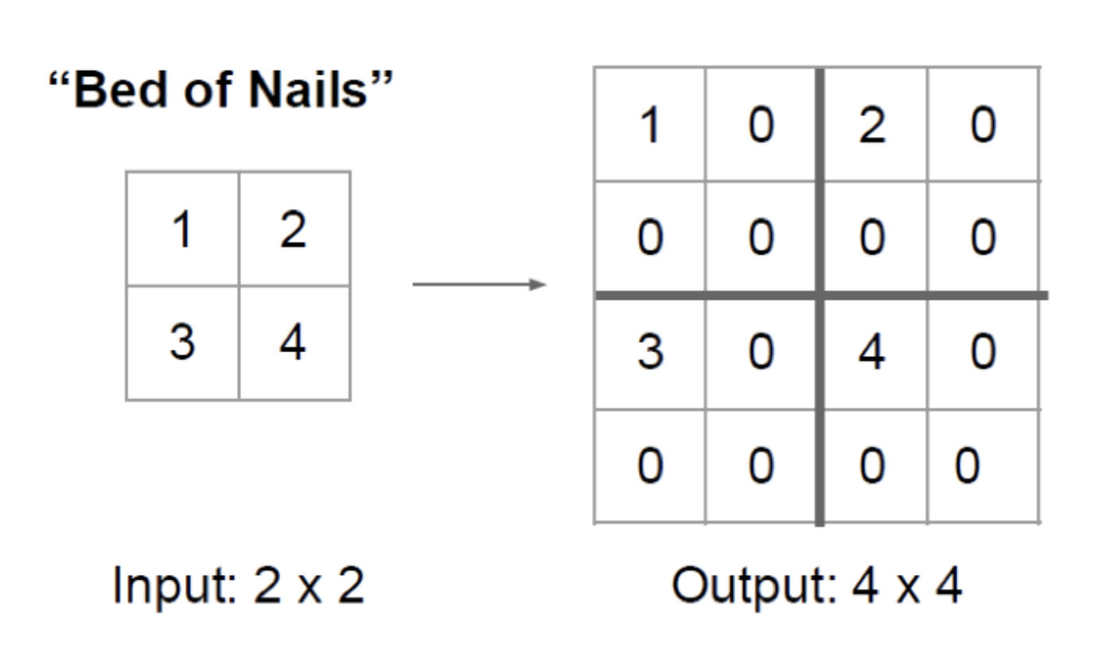
Un-Pooling Layer
(Bed of Nails)
By doing so, it achieves the fine-grained output structure. However, the upsampled elements always have a fixed location, which is the upper-left corner

Slide 93
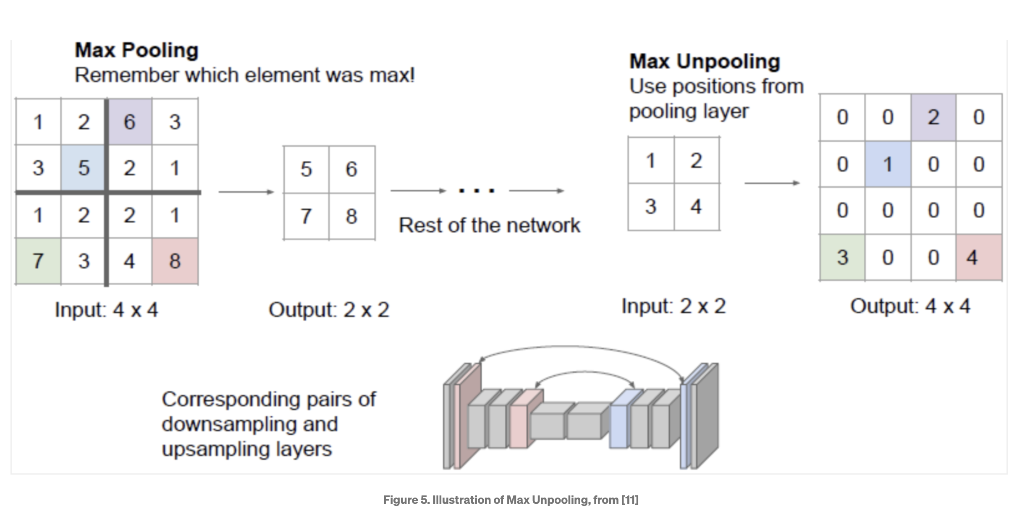
Un-Pooling Layer
(Max Unpooling)

Slide 94
Questions?

